Slide 1

L3 (CHAPTER 6) Programming in Assembly Part 2: Data Manipulation
Acknowledgement: some slides taken from UC Berkeley CS61C courseware

Slide 2
Instruction Set Characteristics
Fixed vs. variable length.
Addressing modes.
Number of operands.
Types of operands.

Slide 3
RISC vs. CISC
Complex instruction set computer (CISC):
Variable instruction lengths
Many addressing modes;
Many operations.
Reduced instruction set computer (RISC):
Fixed instruction length (32-bit for ARM, 16-bit for Thumb)
Few addressing modes;
Few operations.
Notes:
pipelinable instructions.
load/store;

Slide 4
Programming Model
Programming model: registers visible to the programmer.
Some registers are not visible
Invisible: Instruction Register (IR) that holds the current instruction being executed
Visible: Program Counter (PC) that holds the next instruction to be fetched from memory

Slide 5
Multiple Implementations
One instruction set (say ARM) may have different implementations by different companies (Freescale, ST Microelectronics, and many others)
varying clock speeds;
different bus widths;
different cache sizes;
etc.

Slide 6
ARM Assembler Syntax
ARM instructions are written as an operation code (or simply, “opcode”) followed by zero or more operands that may be constants, registers, or memory references
Instructions that transfer data between registers and memory specify two operands (; is followed by comments):
LDR R0,[R1] ;Load register R0 from memory address R1
STR R0,[R1] ;Store register R1 into memory address R1
Arithmetic instructions perform a calculation between two source operands and specify a third destination operand.
ADD R0,R1,#5 ;Replace R0 by sum of R1 and an immediate operand (constant 5)
ADD R2,R3,R4 ;Replace R2 by sum of R3 and R4
opcode | operand₁ | operand₂
LDR | R0 | [R1]
A typical instruction with 2 operands
Instruction LDR R0,[R1]
Notes:
LDR R0,data ;Load register R0 with the content of variable "data”
LDR R0,data+4 ;Load register R0 from an address 4 bytes higher than that of "data"

Slide 7
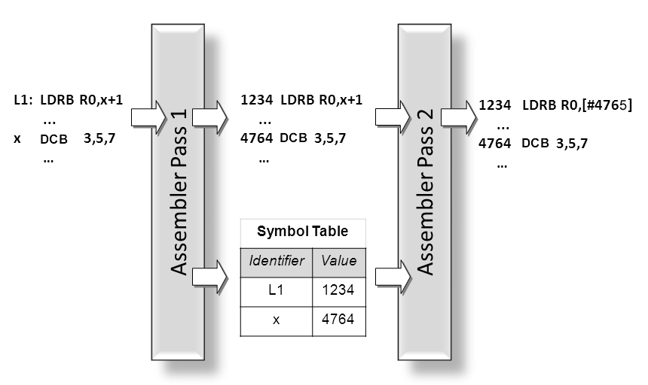
Two-Pass Assembler
The assembler makes two passes over the source code of the program.
During the first pass, it builds a symbol table that contains information about programmer-defined identifiers, such as the address of an instruction represented by a label attached to it, or the address of a variable represented by its identifier.
During the second pass, it uses this information to assemble the representation of the individual instructions.

Slide 8
ARM Data Types
1 word = 4 bytes = 32 bits
ARM address is 32 bits long.
Address refers to byte.
Address 4 starts at byte 4.
Can be configured at power-up as either little- or big-endian.

Slide 9
ARM Registers
R0
R1
R2
R3
R4
R5
R6
R7
R8
R9
R10
R11
R12
R13: Stack Pointer (SP)
R14: Link Register (LR)
R15: Program Counter (PC)
Thumb Mode (16-bit instr):
8 general purpose registers
ARM Mode (32-bit instr):
15 general purpose registers
7 “high” registers
R8-R12 only accessible with MOV, ADD, or CMP
Notes:
13 general-purpose registers (R0 through R12) and three special-purpose registers (R13, R14, and R15).
R15 is used as the PC (Program Counter), R13 as the SP (Stack Pointer), and R14 as the LR (Link Register) that holds the return address when a subroutine is called.

Slide 10
Status Registers (xPSR)
A 32-bit PSR (Program Status Register) stores a collection of 1-bit status flags and other information, divided into three bit fields:
APSR (Application Program Status Register), IPSR (Interrupt Program Status Register), and EPSR (Execution Program Status Register).
PSR = APSR | IPSR | EPSR (“|” stands for bitwise OR)
CPSR (Current Program Status Register) holds PSR of the current instruction being executed
31 | 30 | 29 | 28 | 27 | 26 | 25 | 24 | 23 |  | 16 | 15 |  | 10 | 9 | 8 |  | 0
N | C | Z | V | Q
 |  |  |  |  |  |  |  |  |  |  |  |  |  |  | 0 or exception #
 |  |  |  |  | ICI/IT |  | T |  |  |  | ICI/IT
APSR
IPSR
EPSR

Slide 11
Important Bit Flags in CPSR
Bits | Name | Description
31 | N | Negative (bit 31 of result is 1)
30 | C | Unsigned Carry
29 | Z | Zero or Equal
28 | V | Signed Overflow
Most important for application programming
Every arithmetic, logical, or shifting operation sets CPSR bits:
N – Negative
is set if the result of a data processing instruction was negative.
Z – Zero
is set if the result was zero.
C – Carry
is set if true result > 2^{n}-1 for unsigned addition, or true result < 0 for unsigned subtraction (n=32 for ARM instruction set).
V – Overflow
is set if true result > 2^{n-1}-1 or true result < -2^{n-1} for signed addition or subtraction (n=32 for ARM instruction set).
Notes:
is set if an addition, subtraction or compare causes a result bigger than 32 bits, or is set from the output of the shifter for move and logical instructions. is set if an addition, subtraction or compare produces a signed result bigger than 31 bits.

Slide 12
Loading Constants: MOV and MVN
MOV r_{d},constant
MOV instruction copies constant into register r_{d};
Cannot support the full range of 32-bit values since only a small number of bits of the instruction are used to hold the constant. As a result, constants are limited in the range of 0 to 255 (8 bits).
Example: MOV R1,#100 ;R1 is assigned decimal number 100
MVN r_{d},constant
MVN (MOV Negated) instruction copies ~constant (inverse of constant) into register r_{d};
Effectively doubles the # of constants
Assembler converts MOV w/neg. const to MVN.
Example: MVN R1,#100 ;R1 is assigned ~100 (decimal number −101 based on two’s complement encoding)
MOV R0, R1 ; set R0 to R1
MON R0, R1 ; set R0 to negated R1
Notes:
MOV R1,#100 ;R1 d 100
MVN R1,#100 ;R1 d ~100 (same as R1 d −101)

Slide 13
Loading Constants: LDR
LDR r_{d},=constant
A special “pseudo-operation” that will work for any constant up to 32 bits wide.
You simply write what appears to be a regular ARM instruction (except that an equal sign is substituted for the pound sign) and let the assembler sort out the most efficient way to achieve your objective:
Converted to MOV or MVN if possible
Else converts to LDR r_{d},[pc,#imm]
Examples:
LDR R1,=10 ;assembler replaces this by MOV R1,#10.
LDR R1,=−15 ;assembler replaces this by MVN R1,#14.
LDR R1,=−127435 ;assembler replaces this by a memory reference instruction that loads the constant −127435 from a separate memory location.

Slide 14
LDRH (Load Halfword)
15 | 0
16-bit Memory Half-Word (unmodified)
0 0 | 0 0
. . . . . . . . . .
. . . . . . . . . .
32-bit Register
31 |  |  | 16 | 15 |  |  | 0
When loading 8- or 16-bit data into a 32-bit register, the operand itself is always right justified within the register and its most significant bits filled according to whether the value is signed or unsigned. Unsigned operands less than 32 bits wide must fill the extra bit positions with zeroes (called “zero-filling”).
Notes:
when loading 8- or 16-bit data into a 32-bit register, the operand itself is always right
justified within the register and its most significant bits filled according to whether the
value is signed or unsigned

Slide 15
LDRSH (Load Signed Halfword)
15 | 0
16-bit Memory Half-Word (unmodified)
. . . . . . . . . .
. . . . . . . . . .
32-bit Register
31 |  |  | 16 | 15 |  |  | 0
Signed operands less than 32 bits wide must fill the extra bit positions with copies of their sign bit

Slide 16
Load (from memory) Instructions
Load/Store Memory | Operation | Notes
LDR r_{d},<mem> | r_{d} ← mem₃₂[address]
LDRB r_{d},<mem> | r_{d} ← mem₈[address] | Zero fills
LDRH r_{d},<mem> | r_{d} ← mem₁₆[address] | Zero fills
LDRSB r_{d},<mem> | r_{d} ← mem₈[address] | Sign extends
LDRSH r_{d},<mem> | r_{d} ← mem₁₆[address] | Sign extends
LDRD r_{t},r_{t2},<mem> | r_{t2}. r_{t} ← mem₆₄[address]
Notes:
These instructions never affect flags in xPSR!

Slide 17
STRH (Store Halfword)
31 |  |  | 16 | 15 |  |  | 0
32-bit Register (unmodified)
Most-significant 16 bits are not written into memory
. . . . . . . . . .
16-bit Memory Half-Word
15 | 0
Writing a half-word result to address 104: The two memory bytes that should be written are at addresses 104 and 105. However, the 32-bit memory data bus is actually 4 bytes wide, corresponding to addresses 104, 105, 106, and 107. Each byte of the memory data bus has its own write enable; during the memory write cycle, the write-enable signals for addresses 106 and 107 are disabled so that only the bytes at addresses 104 and 105 are modified.

Slide 18
Store (to memory) Instructions
Load/Store Memory | Operation | Memory Byte Addresses Actually Written
STR r_{d},<mem> | r_{d} → mem₃₂[addr] | addr+3 | addr+2 | addr+1 | addr
STRB r_{d},<mem> | r_{d} → mem₈[addr] |  |  |  | addr
STRH r_{d},<mem> | r_{d} → mem₁₆[addr] |  |  | addr+1 | addr
STRD r_{t}, r_{t2},<mem> | r_{t2}.r_{t} → mem₆₄[addr]
Notes:
These instructions never affect flags in xPSR!

Slide 19
Summary of LDR/STR Commands
signed long int
unsigned long int
int_32, uint_32
unsigned char
unsigned short int
uint_8
uint_16
LDR/STR
LDRB/STRB
LDRH/STRH
32-bit register(s)
signed char
LDRSB/STRB
LDRSH/STRH
signed short int
int_8
LDRD/STRD
int_16
signed long long int
unsigned long long int
int_64, uint_64

Slide 20
Addressing Modes
Offset addressing (most important):
LDR R1,[R0] ;Load R1 from memory address R0
LDR R1,[R0,#16] ;Load R1 from memory address R0+16
Auto-indexing with pre-indexed addressing mode:
LDR R1,[R0,#16]! ;Load from memory address R0+16, then ;update R0 = R0+16
Auto-indexing with post-indexed addressing mode:
LDR R1,[R0],#16 ;Load R0 from memory address R0, then
;update R0 = R0+16
Notes:
Program counter (PC)-relative addressing mode:
LDR R0, [R15, #24] ;loads R0 with the word pointed at by PC+24

Slide 21
Offset Addressing
Syntax | Memory Address | Example
[r_{n}] | r_{n} | [R5]
[<r_{n}>,#imm] | r_{n} + imm | [R5,#100]
[<r_{n}>,<r_{m}>] | r_{n} + r_{m} | [R4,R5]
[<r_{n}>,<r_{m}>,LSL #<imm>] | r_{n} + (r_{m} << imm) | [R4,R5,LSL #3]
Quiz: How can you put a 32-bit memory address into a 32-bit instruction?
Answer: The memory address is stored in a register r_{n}. For ARM instruction, only 4 bits are need to encode ID of register r_{n} (since there are a total of 15 general-purpose registers).
LDR | R0 | [r_{n}]
A typical instruction with 2 operands

Slide 22
Using Offset Addressing
C: Assembler:
int *p ; LDR R0,=0
... LDR R1,p
*p = 0 ; STR R0,[R1] % Store 0 into memory address R1
C: Assembler:
int *p ; LDR R0,=0
… LDR R1,p
*(p + 1) = 0 ; STR R0,[R1,#4] % Store 0 into memory address R1+4， % since a long is 4 bytes, so adding 1 to pointer p % increments the memory address by 4
Notes:
long *p, k ; → LDR R0,=0
… LDR R1,p
*(p + k) = 0 ; LDR R2,k
STR R0,[R1,R2,LSL #2]

Slide 23
Offset Addressing for Arrays
C: Assembler:
a8[0](1Byte)
a8[1](1Byte)
a8[2](1Byte)
a8[3](1Byte)
a8[4](1Byte)
a8[5](1Byte)
a8[6](1Byte)
a8[7](1Byte)
char a8[100]; LDR R0,=0
int k; ADR R1,a8
… LDR R2,k
a8[k] = 0 ; STRB R0,[R1,R2] % Store 0 into memory address a8+k*1, since a % char is 1 Byte
short a16[100]; LDR R0,=0
… ADR R1,a16
a16[5] = 0 ; STRH R0,[R1,#10] % Store 0 into memory address a16+5*2, since % a short is 2 Bytes
int a32[100]; LDR R0,=0
ADR R1,a32
… LDR R2,k
a32[k] = 0 ; STR R0,[R1,R2,LSL #2] % Store 0 into memory address a32+k*4, % since an int is 4 Bytes
a8
a8+1
a8+2
a8+3
a8+4
a8+5
a8+6
a8+7
a8+8
a16[0](2 Bytes)
a16[1](2 Bytes)
a16[2](2 Bytes)
a16[3](2 Bytes)
a16
a16+1
a16+2
a16+3
a16+4
A32[0](4 Bytes)
A32[1](4 Bytes)
a32
a32+1
a32+2
For an array x[N], x[n] is the element stored at memory address x+n*(sizeof(x)).

Slide 24
Address Calculation
R_{n}
Instruction Register
constant
Pre- and Post-Indexed modes update R_{n}
#constant
s
w
i
t
c
h
Post-Indexed address
R_{m}
R_{m}
+
Memory Address (Offset and Pre-Indexed Modes)
left shifter
R_{m},LSL #constant
It illustrates how offset addressing can use registers, a shifter, and a small constant to generate the address of an instruction operand.

Slide 25
Pre-Indexed Addressing
Instruction Register
 | imm
R_{n}
#imm
s
w
i
t
c
h
R_{m}
R_{m}
+
Effective Address
left shifter
R_{m},LSL #imm

Slide 26
Post-Indexed Addressing
Instruction Register
 | imm
R_{n}
#imm
s
w
i
t
c
h
Effective Address
R_{m}
R_{m}
+
left shifter
R_{m},LSL #imm

Slide 27
ARM ADR Pseudo-op
ADR pseudo-op generates instruction required to calculate address:
ADR R1,x ;get memory address of variable x and put it in register R1
Notes:
Generate value by performing arithmetic on PC. Cannot refer to an address directly in an instruction.

Slide 28
Example 1: Assignment
C:
//assume x, a, b are 32-bit integer variables
x = a - b;
Assembler:
ADR R4,a ; get address for a
LDR R0,[R4] ; get value of a
ADR R4,b ; get address for b, reusing R4
LDR R1,[R4] ; get value of b
SUB R0,R0,R1 ; subtract R1 from R0, and store result in R0
ADR R4,x ; get address for x
STR R0,[R4] ; store value of x into memory
Notes:
label1 ADR R4,c ; take memory address of variable c and put it ; into register R4
LDR R0,[R4] ; load content at memory address R4 into register ; R0
ADR R4,d
LDR R1,[R4]
SUB R0,R0,R1 ; subtract R1 from R0, and store result in R0 ; (R0 -= R1)

Slide 29
Example 2: Assignment
C:
//assume x, a, b, c are 32-bit integer variables
x = (a + b) - c;
Assembler:
ADR R4,a ; get address for a
LDR R0,[R4] ; get value of a
ADR R4,b ; get address for b, reusing R4
LDR R1,[R4] ; get value of b
ADD R3,R0,R1 ; compute a+b with R3=R0+R1
ADR R4,c ; get address for c
LDR R2,[R4] ; get value of c
SUB R3,R3,R2 ; compute x with R3 -= R2
ADR R4,x ; get address for x
STR R3,[R4] ; store value of x into memory
Can use R0 to replace R3 in this code, to reduce number of registers used, as in Example 1

Slide 30
Example 3: Assignment
C:
//assume y, a, b, c are 32-bit integer variables
y = a*(b+c);
Assembler:
ADR R4,b ; get address for b
LDR R0,[R4] ; get value of b
ADR R4,c ; get address for c
LDR R1,[R4] ; get value of c
ADD R2,R0,R1 ; compute partial result b+c
ADR R4,a ; get address for a
LDR R0,[R4] ; get value of a
MUL R2,R2,R0 ; compute final value for y=a*(b+c)
ADR R4,y ; get address for y
STR R2,[R4] ; store value of y into memory

Slide 31
Example 4: Assignment
C:
//assume z, a, b are 32-bit integer variables
z = (a << 2) | (b & 15);
Assembler:
ADR R4,a ; get address for a
LDR R0,[R4] ; get value of a
MOV R0,R0,LSL 2 ; perform shift a<<2
ADR R4,b ; get address for b
LDR R1,[R4] ; get value of b
AND R1,R1,#15 ; perform AND
ORR R1,R0,R1 ; perform OR
ADR R4,z ; get address for z
STR R1,[R4] ; store value for z

Slide 32
Bitwise Instructions
Bitwise Instructions | Operation | {S} | <op> | Notes
AND R_{d},R_{n},<op> | R_{d} ← R_{n} & <op> | NZC | imm. const. -or- reg{,<shift>}
ORR R_{d},R_{n},<op> | R_{d} ← R_{n} | <op> | NZC
EOR R_{d},R_{n},<op> | R_{d} ← R_{n} ^ <op> | NZC |  | Exclusive OR
BIC R_{d},R_{n},<op> | R_{d} ← R_{n} & ~<op> | NZC |  | Bit Clear
ORN R_{d},R_{n},<op> | R_{d} ← R_{n} | ~<op> | NZC |  | OR Not
MVN R_{d},R_{n} | R_{d} ← ~R_{n} | NZC |  | Move Not

Slide 33
Bitfield Instructions
Bitfield Instructions | Operation | {S} | Notes
BFC R_{d},#lsb,#width | R_{d}<bits> ← 0 | n/a
BFI R_{d},R_{n},#lsb,#width | R_{d}<bits> ← R_{n}<lsb’s> | n/a
SBFX R_{d},R_{n},#lsb,#width | R_{d} ← R_{n}<bits> | n/a | Sign extends
UBFX R_{d},R_{n},#lsb,#width | R_{d} ← R_{n}<bits> | n/a | Zero extends

Slide 34
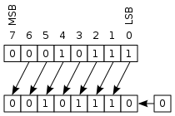
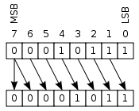
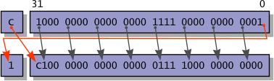
Shift Instructions
<shift> | Meaning | Notes
LSL #n | Logical shift left by n bits | Zero fills; 0 ≤ n ≤ 31
LSR #n | Logical shift right by n bits | Zero fills; 1 ≤ n ≤ 32
ASR #n | Arithmetic shift right by n bits | Sign extends; 1 ≤ n ≤ 32
ROR #n | Rotate right by n bits | 1 ≤ n ≤ 32
RRX | Rotate right w/C by 1 bit | including C bit from CPSR
LSL #1
LSR #1
Any of these may be applied to the 2nd operand register in Move / Add / Subtract, Compare, and Bitwise Groups.
RRX

Slide 35
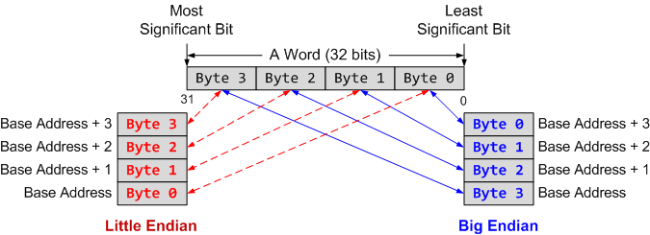
Summary
Memory address is always in terms of bytes.
How data is organized in memory?
How data is addressed?
Addressing Format | Example | Equivalent
Pre-index | LDR r1, [r0, #4] | r1 ← memory[r0 + 4], r0 is unchanged
Pre-index with update | LDR r1, [r0, #4]! | r1 ← memory[r0 + 4] r0 ← r0 + 4
Post-Index | LDR r1, [r0], #4 | r1 ← memory[r0] r0 ← r0 + 4

